Slide 1
How to Replace Kitchen Sink
Haifei Cheng
2025-04-02

Slide 2
Outline
Background
Preparation
Steps
Challenge
Hook
Leak
Acknowledgement

Slide 3
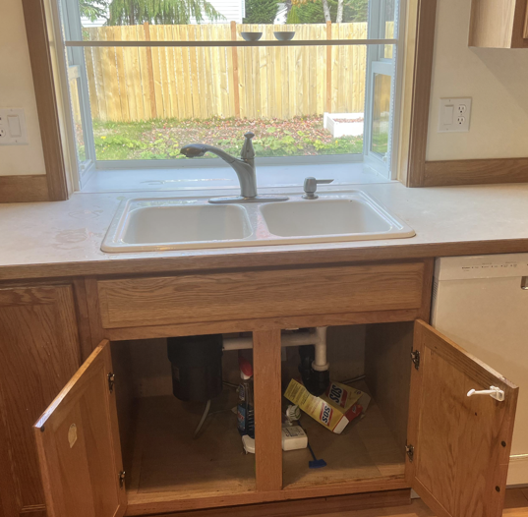
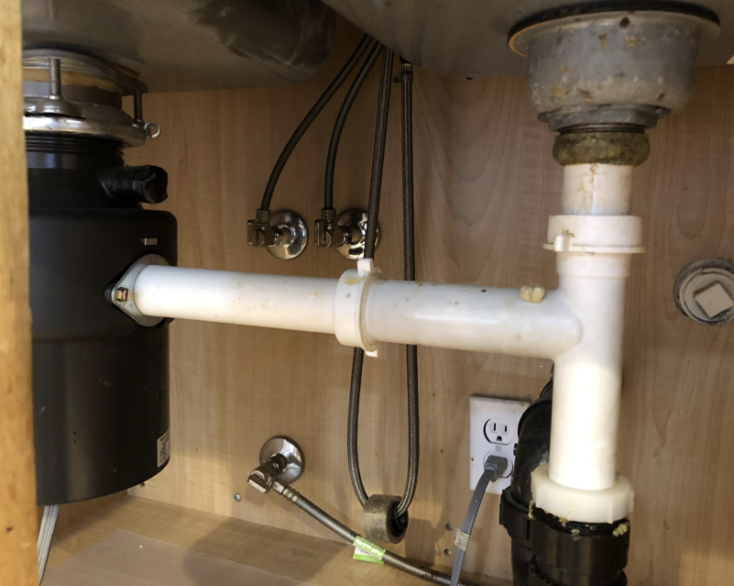
Task: Replace the aging kitchen sink

Slide 4
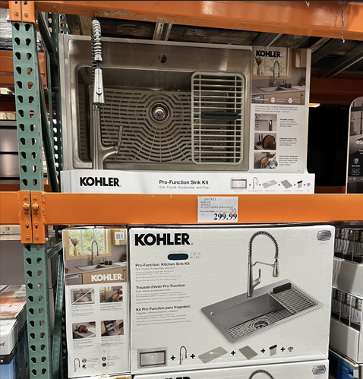
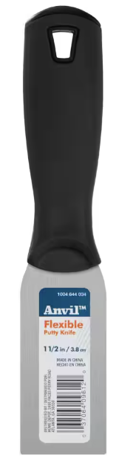
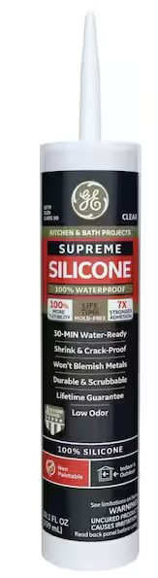
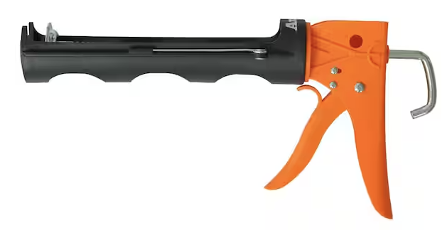

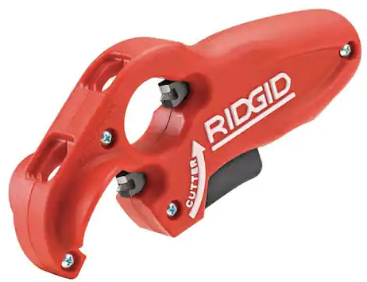
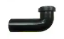
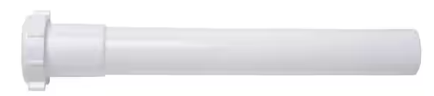
Preparation
Check the exiting sink
Dimension
Drop-in v.s. Undermount
Watch tutorials in Youtube
Timing planning
Make a shopping list:

Slide 5
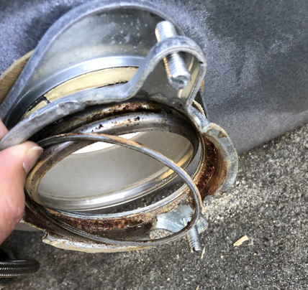
Step 1 – Remove old sink
Close the water valves.
Make sure food disposer is not connected with the dish washer.
Unplug food disposer power line.
Detach the food disposer.
Frequently take pictures, and pay attention to how to put it back later.
Use putty knife to detach old sink with the counter.

Slide 6
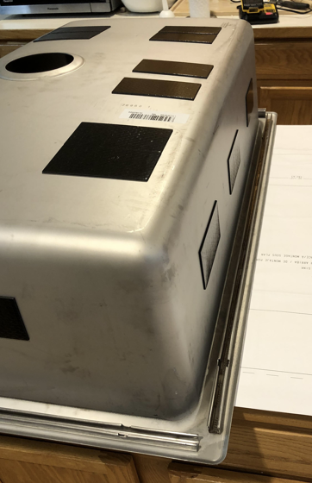
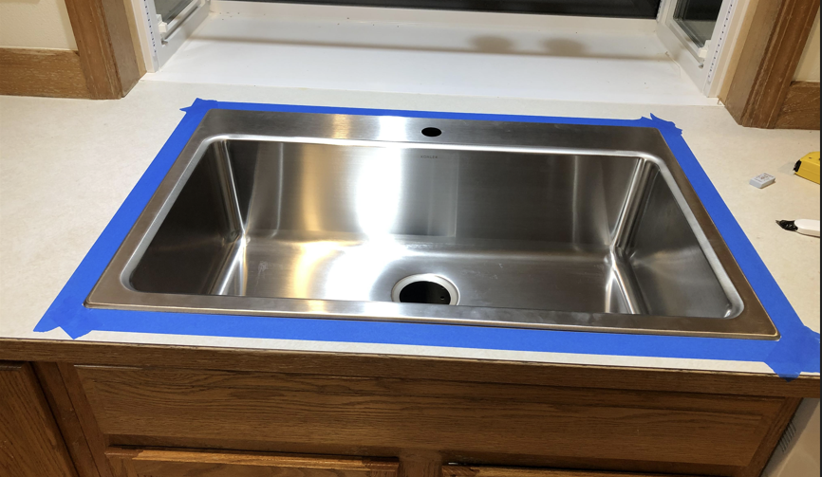
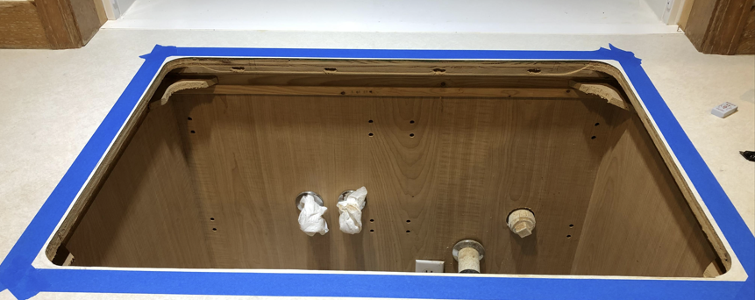
Step 2 – Align and Test
Sink cutout is slightly small then the sink
Use painter tape to mark the position
Test using screw to secure the sink to the cutout

Slide 7
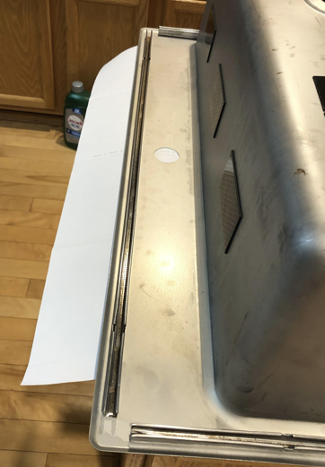
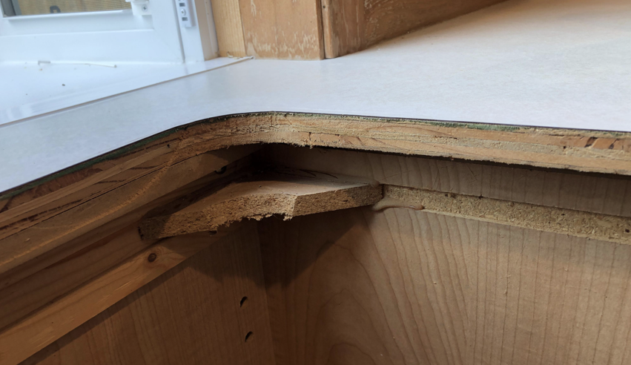
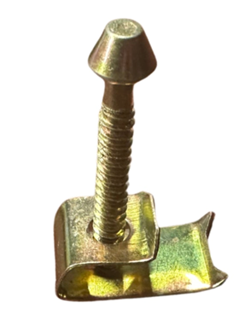
Challenge 1
Front and back edge is too thick for the hook screw
Buy new screw?

Slide 8
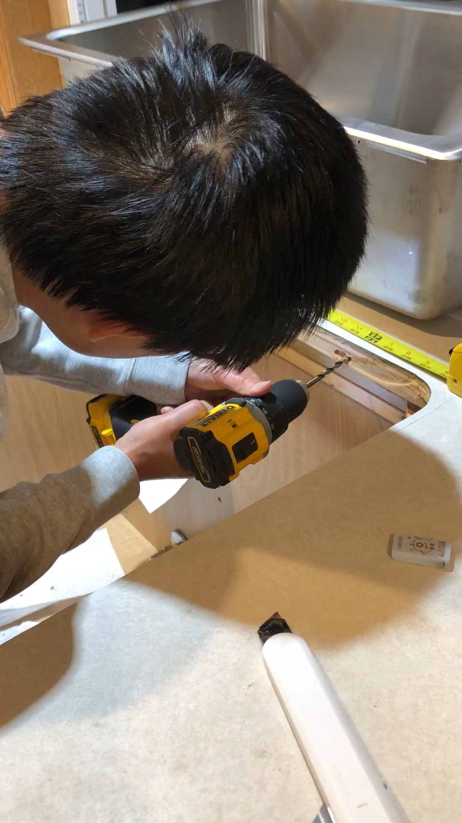

Solution
Drill rectangular holes on frond and back edges. 4 holes each side.

Slide 9
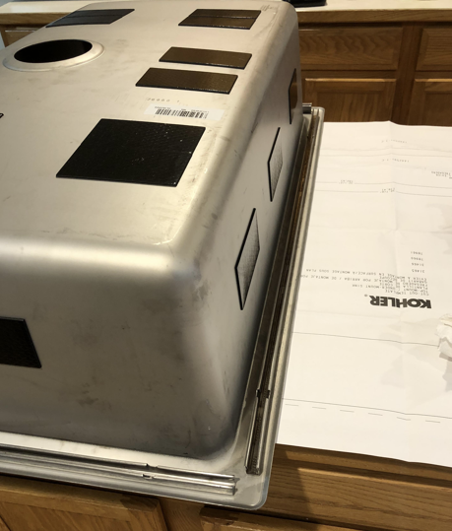
Step 3 – Install Sink
Apply Silicon gel
Tighten the screw
Clean the excessive gel around the sink edge

Slide 10
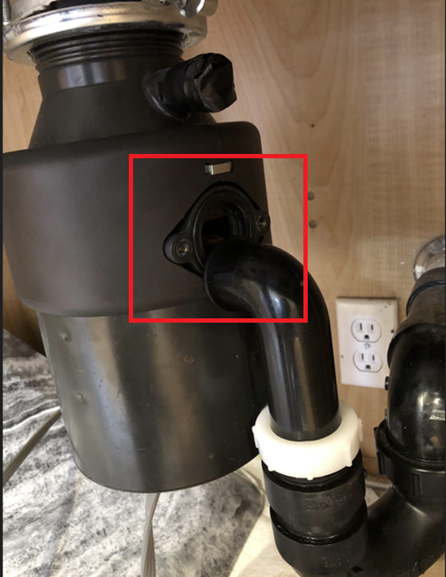
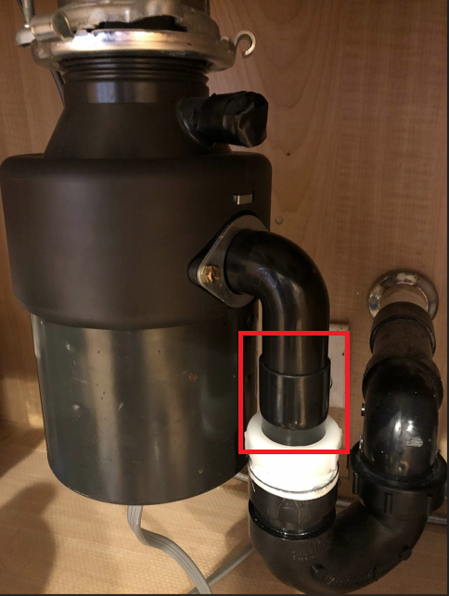
Step 4 – Install Food Disposer
Pipe is not high enough to match the outlet of food disposer.

Slide 11
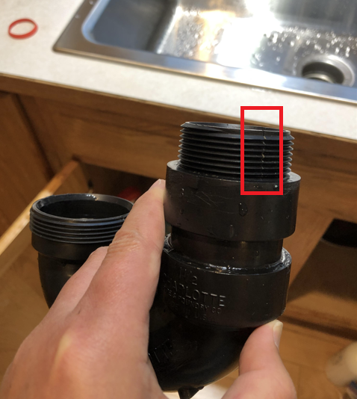
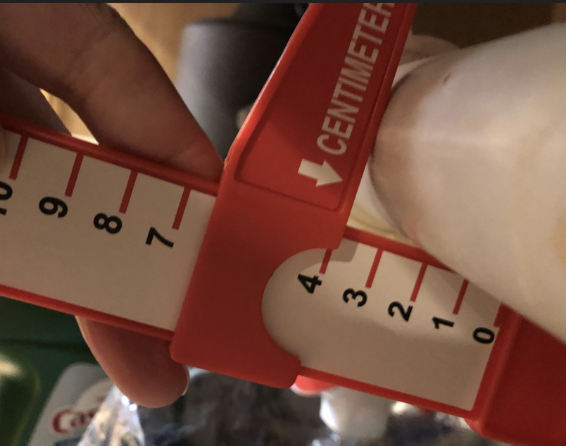
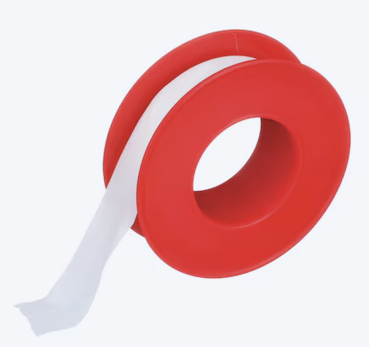
Challenge 2
Pipe leak
No same diameter P-Trap in Home Depot.
Solution: Thread seal tape

Slide 12
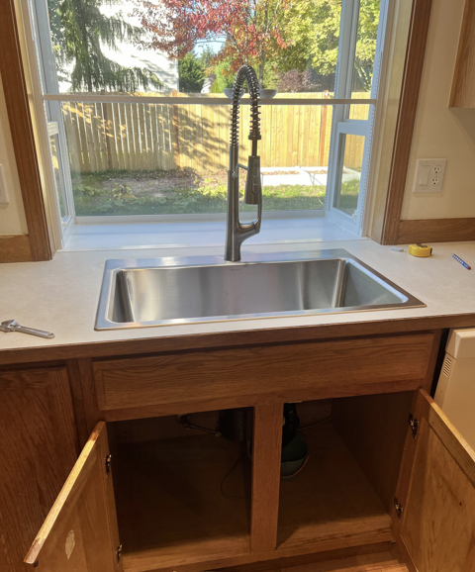

Final product
Joyful every time I use it.

Slide 13
4 Trips to Home Depot
Trip 1:
Talk with plumber.
Buy accessories.
Trip 2:
Looking for long screws.
Get additional silicon gel.
Trip 3:
Talk with plumber about short pipe
Buy pipe cutter and extended pipe
Trip 4:
Return unused accessories.

Slide 14
Acknowledgement
Internet
The Home Depot
US civil construction standard
Small antidote
Converting HEIC to JPG

Slide 15
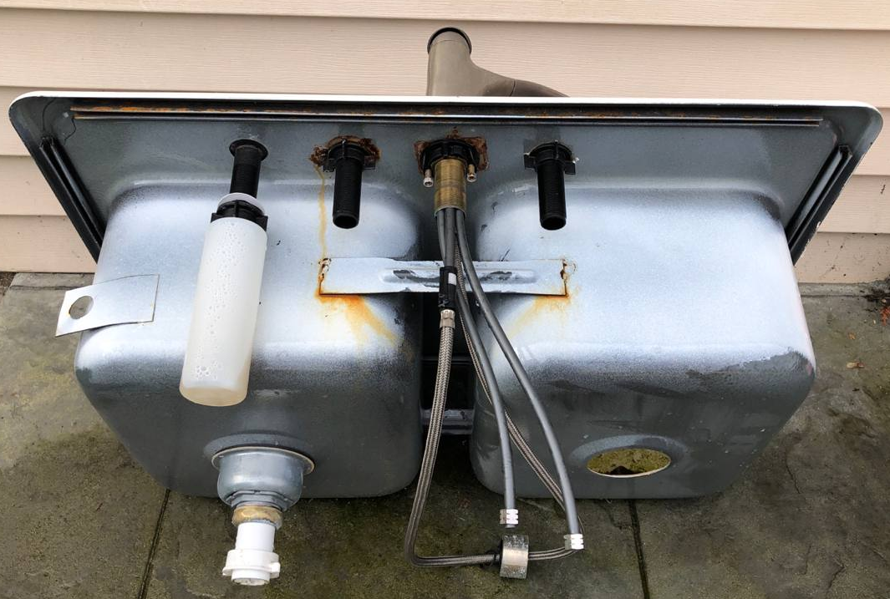
Future work
How to get rid of the old sink?

Slide 20

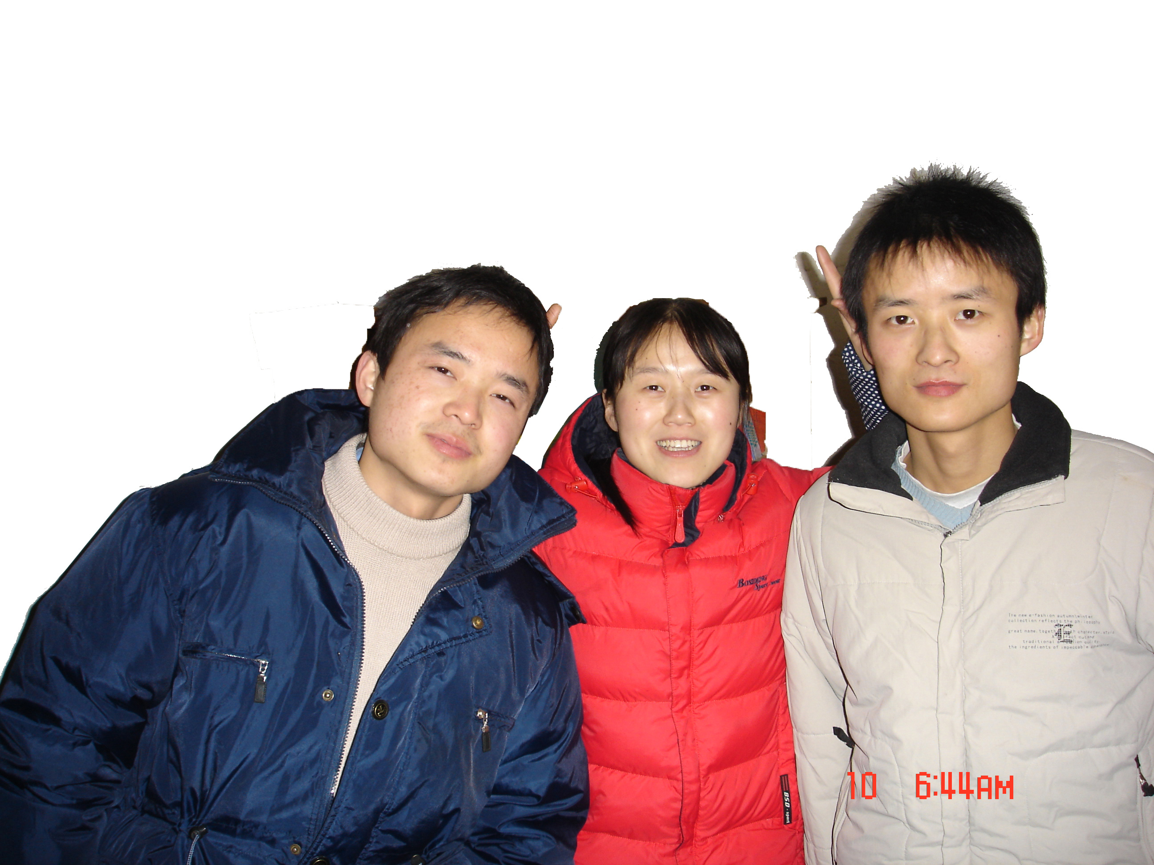


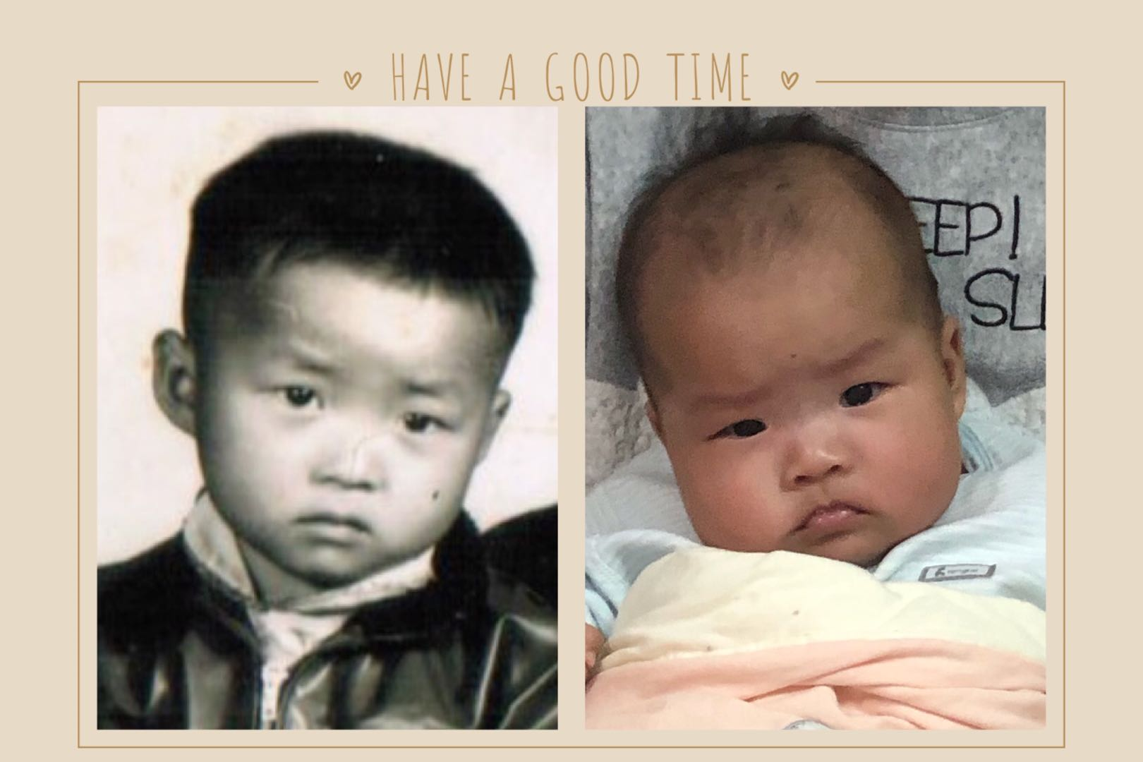
My family

Slide 21
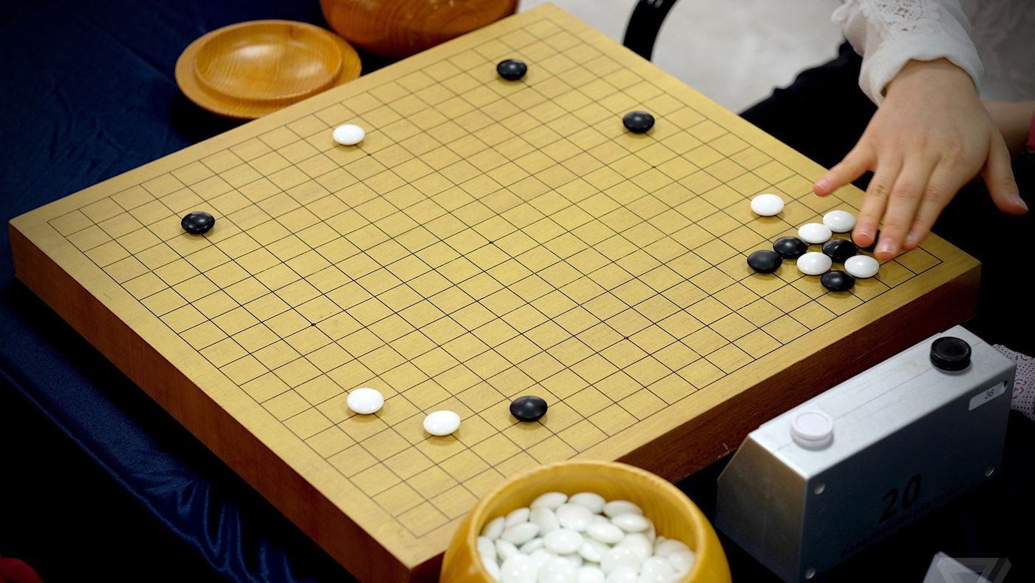
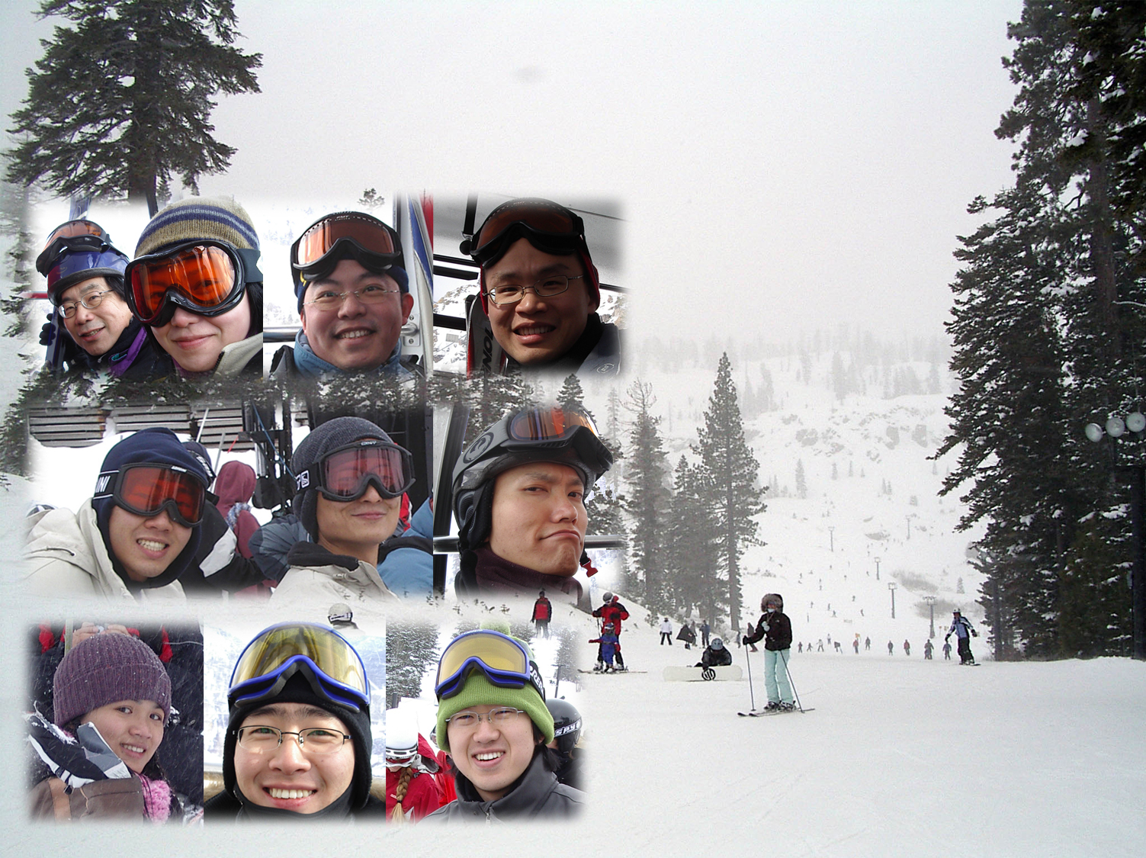
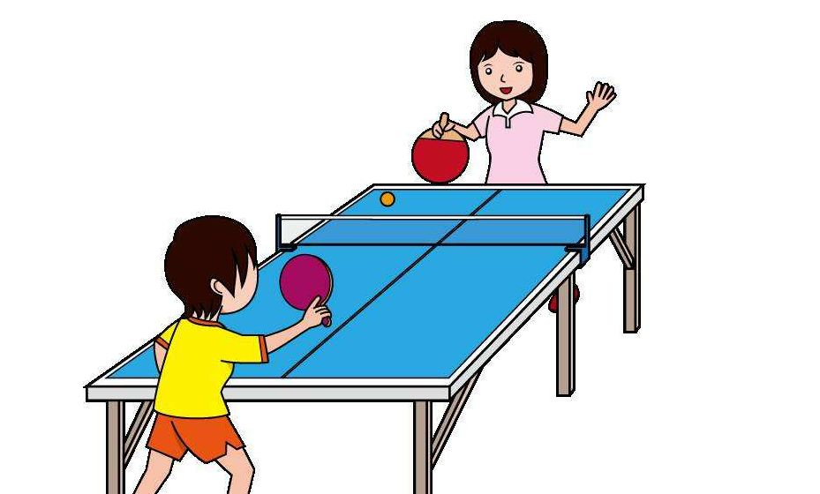
Hobbies – Were

Slide 22



Hobbies – Are

Slide 23




Hobbies - Mind Random Walk
1:00 am?
Notes:
Where is boundary, how to understand 4D space.

Slide 24

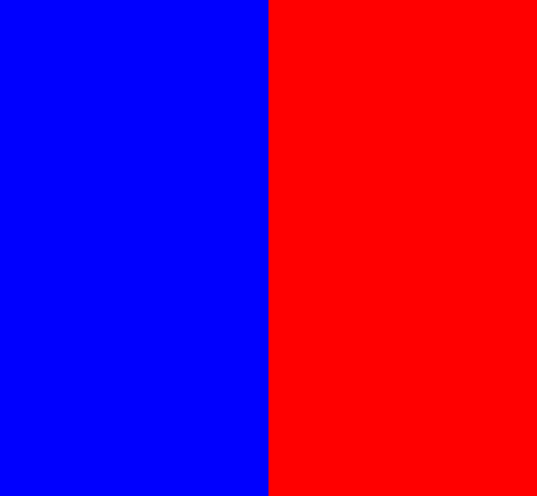
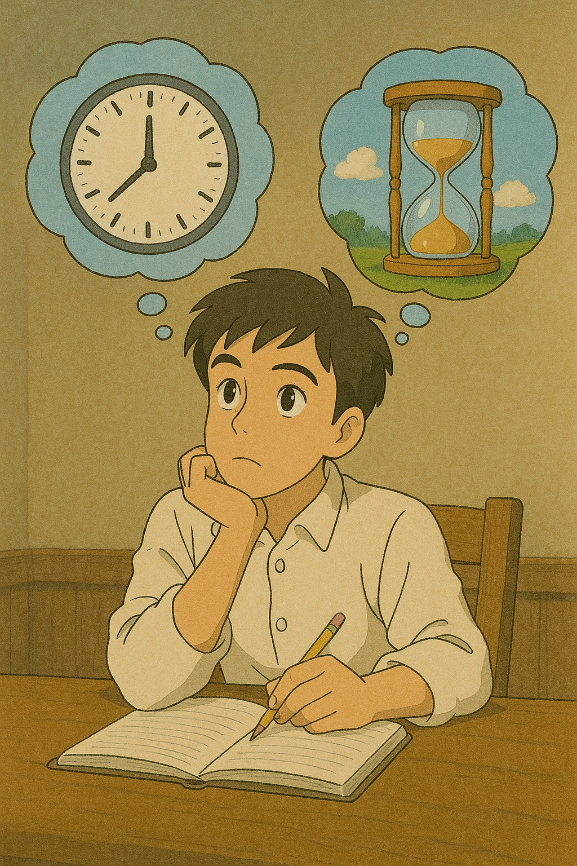

Hobbies – Mind Random Walk
Notes:
Where is boundary, how to understand 4D space.

